Slide 1
Digital Humanities Master at Linnaeus University Koraljka Golub
Digital Humanities:
Empowering Visibility of Croatian Cultural Heritage
2nd International Symposium
Zadar, 6-8 November 2017

Slide 2
Digital Humanities Initiative at LNU
https://lnu.se/en/digihum/
Why: address societal challenges
How: Research + Education + Network
Cross-sectoral
Cross-disciplinary
International
Research
10 pilots in 2016
Funding received for 2017 “Creating attractive information landscapes for cultural events”
DISA https://lnu.se/disa
Network
117 members in the network as of today
42 from LNU, 12 departments
IEC with over 200 IT companies
GLAM in the region and abroad
Academic members from 17 countries on 5 continents
DARIAH-EU

Slide 3
DH education at LNU: overall idea…
Vision
Addressing future societal challenges would be eventually possible by highly skilled professionals whose education has been markedly enhanced by practice-informed education and joint, cross-sector innovation
A (re)-affirmation of the value of humanities in particular, and academic practices in general
An attractive mixture of compulsory and facultative courses
Common core
Disciplinary-specific electives

Slide 4
…DH education at LNU: overall idea…
To formalize LNU´s vision about cross-disciplinary collaboration
8 departments currently represented from 3 faculties (out of 5)
Arts and Humanities: Archeology, Library and Information Science, Linguistics, Film and Literature, Media and Journalism
Technology: Computer Science, Media Technology
Business and Economics
Address needs in the regional public and private sector
Focus-group interview with representatives held in June 2016
Email interview with 13 experts from LNU network
Cross-sectoral collaboration
Project / thesis work
Guest lectures

Slide 5
…DH education at LNU: overall idea
Increase number of (inter)national Master students at LNU
Hybrid or distance
English
Free-of-charge for EU citizens
Both for professionally- and scientifically-oriented students
Both independent courses and full programme
Collaborate with Swedish, Nordic, UK, DARIAH-EU partners and other international universities
Joint courses / student projects
Student exchange
Guest lectures…

Slide 6
Timeline
Concept drafted in the autumn of 2016
Pilot testing of core courses starting in the autumn semester of 2017
Programming for Digital Humanities
15 ECTS, 50%
https://lnu.se/en/course/programming-for-digital-humanities/vaxjo-distance-part-time-autumn/
Full programme to start 2019

Slide 7
Current concept of the Master in DH
FIRST YEAR | Humanities for Technologists (15 credits) or Programming for Humanities (15 credits) |  | Introduction to Digital Humanities (7.5 credits) | Digital Humanities Research Methods (7.5 credits)
 | Elective course 1 (7.5 credits) | Elective course 2 (7.5 credits) | Elective course 3 (7.5 credits) | Elective course 4 (7.5 credits)
SECOND YEAR | Elective course 1 (7.5 credits) | Elective course 2 (7.5 credits) | Master thesis (30 credits)
 | Practicum (15 credits)

Slide 8
Core courses
+ Practicum
+ Master thesis
Humanities for Technologists (15 credits) or Programming for Humanists (15 credits) |  | Introduction to Digital Humanities (7.5 credits) | Digital Humanities Research Methods (7.5 credits)

Slide 9
Electives
A 45p elective module
3 suites: the Humanities, the Technologies, and the Business suite
At least 15p need to be in the Technologies suite for students with the previous Humanities (or other ‘soft’) education
Equivalent in the Humanities for students with previous Computer Science (or related) education
Some courses may belong to more than one suite, like the ones in computational linguistics

Slide 10
Electives in Humanities
Digitization of cultural heritage
Data and information organization and management
Metadata
The transmission of old texts
Digital heritage management and communication
Serious gaming as a resource in the fields of Humanities
Digital translation
Digital lexicography
Data driven approaches to language and text
Business models in value-based organisations and companies
Participative policy development
Digitalisation of working practices
Technoscience studies
Gender issues
Digital media and methods for sampling and analysis
User-generated photography and events
Media – intermedial – multimodal theory

Slide 11
Electives in Technology
Network society and internet cultures
Cross-media design and production
Interactive visualization methods and techniques
Social media ecosystems
Information visualisation
Data literacy
General DH application programmes
Discipline-specific applications
Data sets technologies
Human computer interaction for DH
Database design for DH
Web design for DH
Web programming for DH
Data mining for DH
Notes:
General Digital Humanities application programmes (a content management system (CMS),
like Omeka, WordPress, or Drupal; mapping tools, text analysis tools, data visualization tool)
Discipline-specific applications (e.g., mapping and GIS for archaeologists, text analysis for
linguists)
Data sets technologies (data modelling, how to make a database, an XML document, build an API, use an API, etc.)
Web programming for DH (e.g., Java Script, JQUERY)

Slide 12
Electives in Business
Digital Marketing
Social Media and Consumerism
Business strategy for GLAM
…

Slide 13
Practicum and Thesis
Practicum
Compulsory, 15p
In collaboration with an external partner
A pilot project based on actual needs in the public or private sector
Project management, team working skills
Ideally in pairs with each from different disciplinary background
The basis for thesis writing

Slide 14
Programming for Digital Humanities (4ME501)
The first pilot course
https://lnu.se/en/course/programming-for-digital-humanities/vaxjo-distance-part-time-autumn/
15 ECTS, 50% pace, English
Distance mode with 6 obligatory meetings
Presence either on campus or online
3 major blocks
1: Foundations of programming
2: Text manipulation and visualisation
3: Image, audio, animation
Focus on programming using actual examples from humanities
Popular: over 60 qualified applicants, University of Pisa sent all their students

Slide 15
Related efforts

Slide 16
Discussions on joint courses
Sweden:
Lund University, University of Borås, University of Gothenburg
Finland:
University of Helsinki
Denmark:
Aarhus University
Norway:
Norwegian University for Science and Technology
UK:
University of London, Sheffield University

Slide 17
Workshop at 2nd DHN conference
DHN: Digital Humanities in the Nordic Countries http://dig-hum-nord.eu
Proposed and then co-organized by LNU, as the first of regular workshops on DH education in Nordic countries at DHN annual conferences
As a direct result, a working group on education established with the DHN
Presentations hosted by LNU, linked from DH website https://lnu.se/en/research/searchresearch/digital-humanities/workshop-higher-education-programs-in-digital-humanities-challenges-and-perspectives/
Now proposal submitted for 2nd workshop on DH education in Nordic countries at 3rd DHN conference 2018, Helsinki

Slide 18
DARIAH-EU
A registry of courses related to DH in Europe
https://registries.clarin-dariah.eu/ (universities need to register, so not complete)
DARIAH teach
http://dariah.eu/teach/
Open educational resources, quality controlled
From DHN workshop
Marianne Ping Huang: Digital Humanities education in DARIAH-EU

Slide 19
Nordic collaboration
NORDFORSK – submitted 3 May 2017
By DARIAH Nordic members
Aim: establish Nordic Hub of DARIAH-EU
Collaborate on DH education
Joint electives, summer schools
NEIC
By all Nordic countries and UK
Sweden in DARIAH represented by LNU
Aim: analyze course material in the area of data analytics within large word corpora in Nordic countries, build missing parts, merge etc.
To be submitted under next call

Slide 20
Other on-going efforts
DH seminar series at Linnaeus University
Collaboration with the new established LNUC Data Intensive Sciences and Applications (DISA)
Cross-sectoral project with Nya Småland “Creating Attractive Information Landscapes for Cultural Events”
Establishment of an iSchool at LNU
Sweden as a full partner in DARIAH-EU?
Exploring possibilities

Slide 21
Challenges

Slide 22
Main challenges to address…
Different disciplines and sectors
Epistemological, conceptual and terminological differences
May require additional resources to reach an understanding
Administrative issues with cross-faculty and cross-university collaboration
Current working structures are based on individual units
LNU working example: Innovation through economics, technology and design by 3 faculties (link to FTK’s version)
In particularly challenging in terms of cross-university education
Nordic working example: MA for language teachers, https://lnu.se/program/nordiskt-masterprogram-for-spraklarare/inriktning-engelska-distans-deltid-engelska-ht/

Slide 23
…Main challenges to address
The question of the job market for DH
Low number of students at Master level at LNU / Sweden?
Sustainability
When DH becomes ‘standard’ H
LNU is a young university
Can it attract that many students for a return on investment?

Slide 24
Summary
Overall idea: fulfilling the vision of addressing future societal challenges → cross*
A common core + a large pool of electives
Humanities
Technologies
Related efforts
Challenges

Slide 25
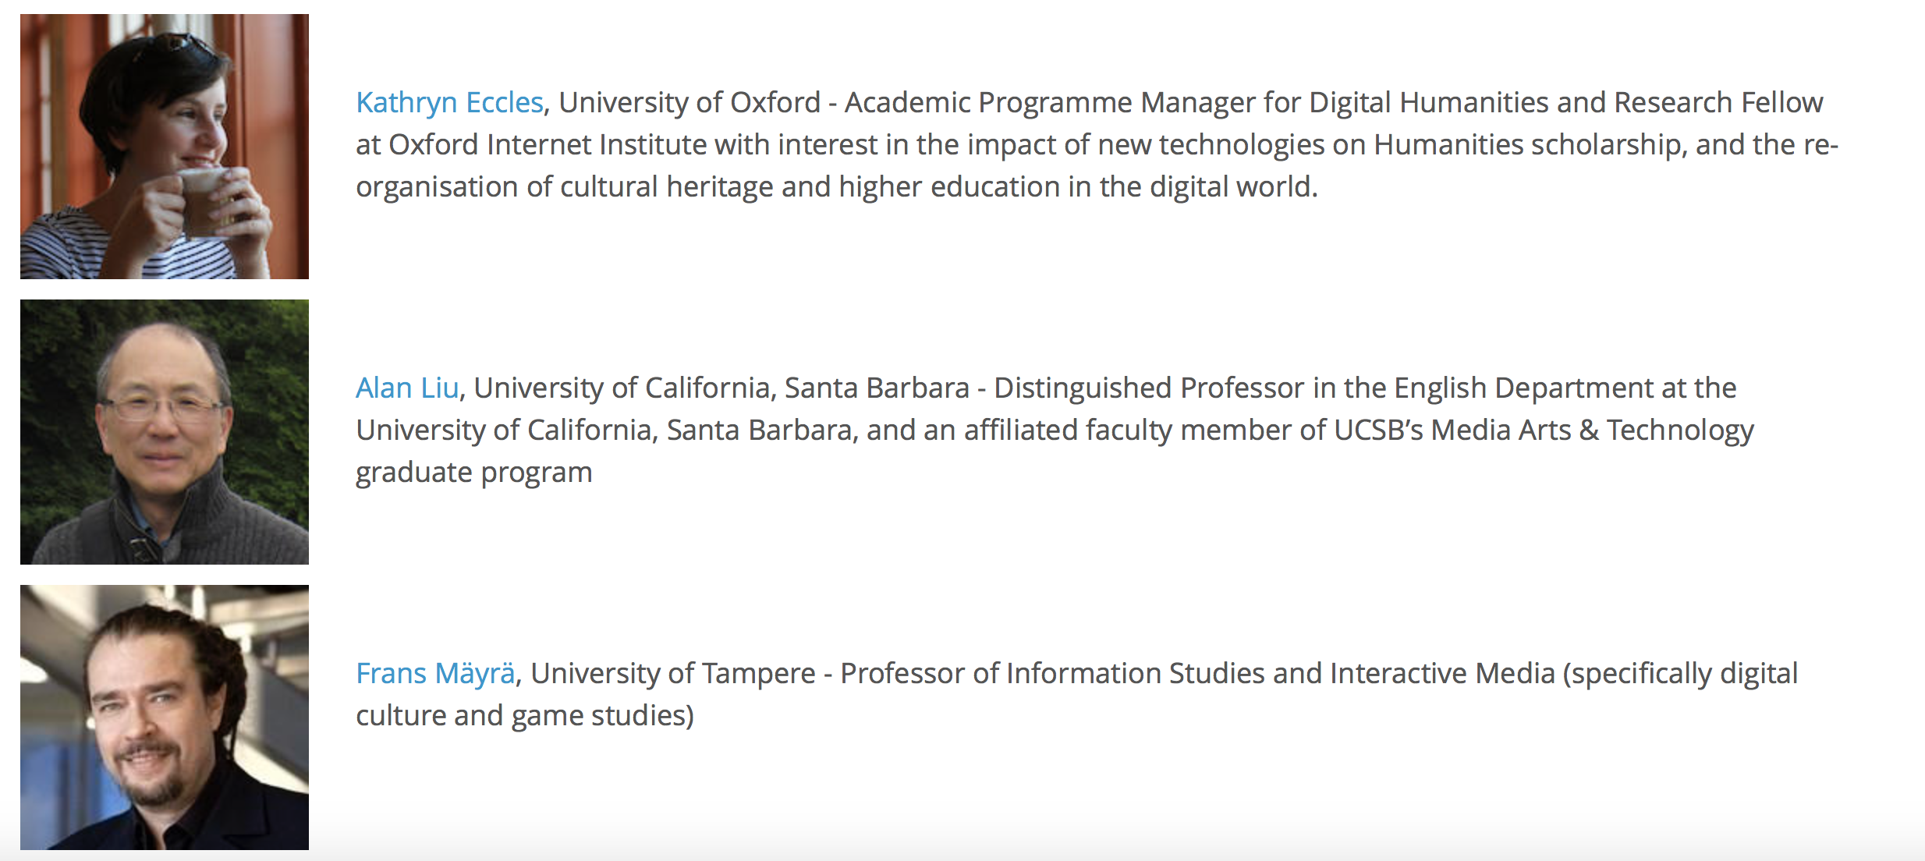
Thank you!
Feedback? Ideas?
Interest in collaboration?
Helsinki and Växjö in March?
Digital Humanities in the Nordic Countries calls for submissions for its 2018 conference in Helsinki, Finland, 7–9 March 2018, http://heldig.fi/dhn-2018/
Email: koraljka.golub@lnu.se

Slide 26
DH education in Europe

Slide 27
Sweden
Undergraduate
Lund
Digitala kulturer: 3 years, campus, Swedish http://www.kultur.lu.se/utbildning/kandidatprogram/kandidatprogram-i-digitala-kulturer/
Graduate
Göteborg
Digital humaniora: 2 years, campus, Swedish and English http://utbildning.gu.se/program/program_detalj/?programid=H2DHU
Post-graduate: courses only
HumLab at Lund
HumLab at Umeå
Notes:
Lund: “Kandidatprogrammet i digitala kulturer vänder sig till dig som vill utforska kulturella perspektiv på samhällets digitala utveckling. Du vill använda denna kunskap för att utveckla digitala strategier, arbeta i olika digitala produktionssammanhang eller jobba med nya sätt att förmedla kultur. Som student inom programmet utvecklar du både teknisk och humanistisk kunskap och kommer att kunna agera som en förmedlande länk mellan olika aktörer inom kulturbranschen men även andra sektorer”

Slide 28
Other Nordic countries
Helsinki
Digital Humanities: Minor Study Block, graduate, 25 ECTS
Bergen
Research training in Digital humanities, advanced level, 15 ECTS
Aarhus
Summer schools

Slide 29
Examples in other Europe
Undergraduate
Tend to be 3 years (180 ECTS), full time, campus mode
Dundalk Institute of Technology (Ireland): Digital Humanities
University College Cork (Ireland): Digital Humanities and Information Technology
King's College London (UK): Digital Culture
University of Wales (UK): Heritage Studies with Digital Humanities
Leipzig University (Germany): Digital Humanities
University of Würzburg (Germany): Digital Humanities

Slide 30
Graduate
Tend to be 1 to 2 years full-time, campus
KU Leuven (Belgium): Digital Humanities
Maynooth University (Ireland): Digital Humanities
Swiss Federal Institute of Technology in Lausanne: Digital Humanities
University of Würzburg: Digital Humanities
UCL (UK): Digital Humanities

