Slide 1
Towards new approaches to editing of old manuscripts and documents
Dr. sc. Martina Kramarić
Institute of Croatian Language and Linguistics, Zagreb
mkramar@ihjj.hr

Slide 2
Old Croatian Literature
Medieval and early Renaissance literature
Three languages: Latin, Old Croatian, and Old Church Slavonic
Three scripts: Old Latin, Glagolitic, and Cyrillic

Slide 3
Digital infrastructure
The online publishing of old texts in XML file format, subsequent mark-up of old texts using TEI tags
„The Text Encoding Initiative (TEI) is a consortium which collectively develops and maintains a standard for the representation of texts in digital form. Its main deliverable is a set of Guidelines which specify encoding methods for machine-readable texts, chiefly in the humanities, social sciences and linguistics. The TEI Guidelines have become an accepted standard for digital text especially where there are concerns about long-term preservation, interchange, or interoperability.“ (http://www.tei-c.org/index.xml)

Slide 4
Croatiae auctores Latini (CroALa) (from 2009)
Faculty of Humanities and Social Sciences, University of Zagreb

Slide 5
EDICIJA – digital library of the Croatian written heritage (2010)
Faculty of Humanities and Social Sciences, University of Osijek

Slide 6
Croatian Language Repository ­­­- Croatian Language Corpus (2011)
Institute of Croatian Language and Linguistics

Slide 7
Digital edition
Glagolitic medieval text Zrcalo člověčaskogo spasenja (1445) from the Miscellany of the Diacon Luka (Zbornik žakna Luke)
XML Editor Editix (one of the possible editors – JEdit, Oxygen etc.) – available online, Free Edition of Editix
Electronic edition for Manuscriptorium.com (CENDARI)

Slide 8
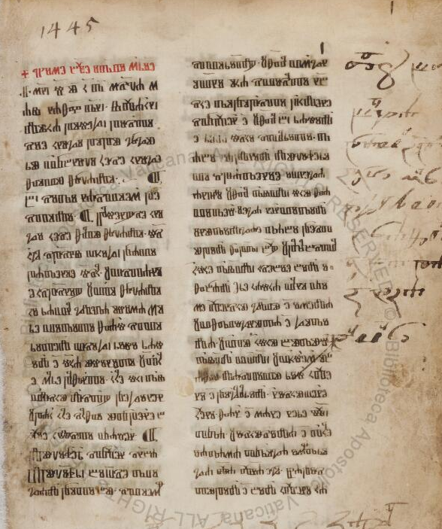
Digital Vatican Library – Zrcalo člověčaskogo spasenja
Sign. Borg. L. VII. 9, illirico 9

Slide 9
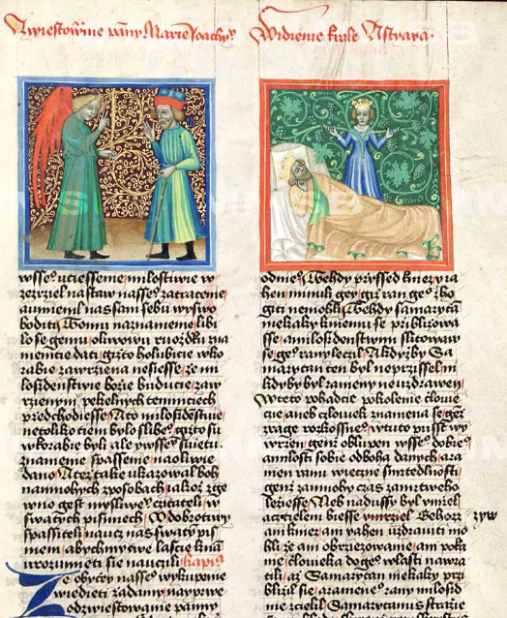
Old Czech template Zrcadlo člověčieho spasenie
Manuscriptorium, sign. III B 10, Krumlov miscellany

Slide 10
Latin original – ­­­­­­­­Speculum Humanae Salvationis
Latin poem (14th)
Critical edition: LUTZ, Jules; PERDRIZET, Paul 1907. Speculum humanae salvationis (transl by Jean Miellot (1448)), Die Quellen des Speculums und seine Bedeutung in der Ikonographie besonders in der elsässischen Kunst des XIV. Jahrhunderts, Band I., Leipzig.

Slide 11
Steps in digitization process
conversion of the digitized manuscript image to the machine-readable text
transforming text from word document into XML form and defining the structure of the document and set of mark-up language
creation of the online publication (HTML)
Structure: TEI header and body

Slide 12
TEI header
<teiHeader><fileDesc> <titleStmt> <title>Zrcalo člověčaskogo spasenja</title> </titleStmt> <editionStmt> <edition>elektronická edice</edition> <respStmt> <resp/> <name ref=""/> </respStmt> <respStmt> <resp>editorka</resp> <name>Martina Kramarić</name> </respStmt> </editionStmt> <publicationStmt> <publisher>Manuscriptorium.com</publisher> </publicationStmt>
<sourceDesc> <listBibl> <bibl> <idno>Borg. L. VII. 9, illirico 9</idno> <note>Zdroj fulltextu. Uložení: <seg type="country">Città del Vaticano</seg> <seg type="settlement">Città del Vaticano</seg> <seg type="repository">Biblioteca Apostolica Vaticana</seg> </note> </bibl> </listBibl> </sourceDesc> </fileDesc></teiHeader>

Slide 13
Body
Module textstructure::<front>, <body> // <div>, <p>, <label>
Elements characteristic for the old documents:
<note>, <supplied>, <pb n="11v"/> and for the corrections:
svezanja<note>
<choice><corr>svezanja</corr>
<sic>svesvezanija</sic></choice></note>

Slide 14
So, what is the next step?

Slide 15
Manuscriptorium Digital library
National Library of the Czech Republic
the second-largest digital library in Europe for for pre-18th-century old manuscripts and documents
publishing of digitized images from manuscripts, as well as the publishing of text from images.

Slide 17
Thank you for your attention!

